Slide 1
Innovation for AAL
MVP presentation

Slide 2




Meet our Team
Luis Alarcon CSCE 22’
Santana Gonzales
ITDE 23’
Juan Perez
ISEN 21’
Mualla Argin
CPSC 23’
Notes:
Juan

Slide 3

Main Problem
***Missing picture
Over $1,200,000 lost in “off ramped” projects.
9 projects
3 years
A project that received a funding but did not get bought or transitioned.
Notes:
Juan

Slide 4
Main Problem
***Missing picture
Over $1,200,000 lost in “off ramped” projects.
100+ projects
3 years
A project that received a funding but did not get bought or transitioned.
Notes:
AAL oversees over 9 projects. Ther

Slide 5

Business Thesis
Our team will identify KPIs that the Army Applications Lab can use to evaluate the success of innovation projects
Notes:
Juan

Slide 6
Innovation Framework
Standardization
Quantitative
Analysis
Standardization
Qualitative Tracking
Our 3 steps to track and measure the success of innovation within your organization
Data Evaluation
Notes:
Luis

Slide 7

Standardization
Implementation policies that will apply to the entirety of the Program Managers to aide in the cohesion and team analysis of projects across the board.
Initial trainings for software and check ups to ensure cohesion
Require microsoft project from every company on all contracts
Use the same metrics/scoring system across all projects
Notes:
Luis

Slide 8

2. Quantitative Tracking
To accurately measure each project, we have created a success monitoring tool that each manager should use on each project.
Touch points
Investments
Milestones
etc.
Notes:
Luis

Slide 9
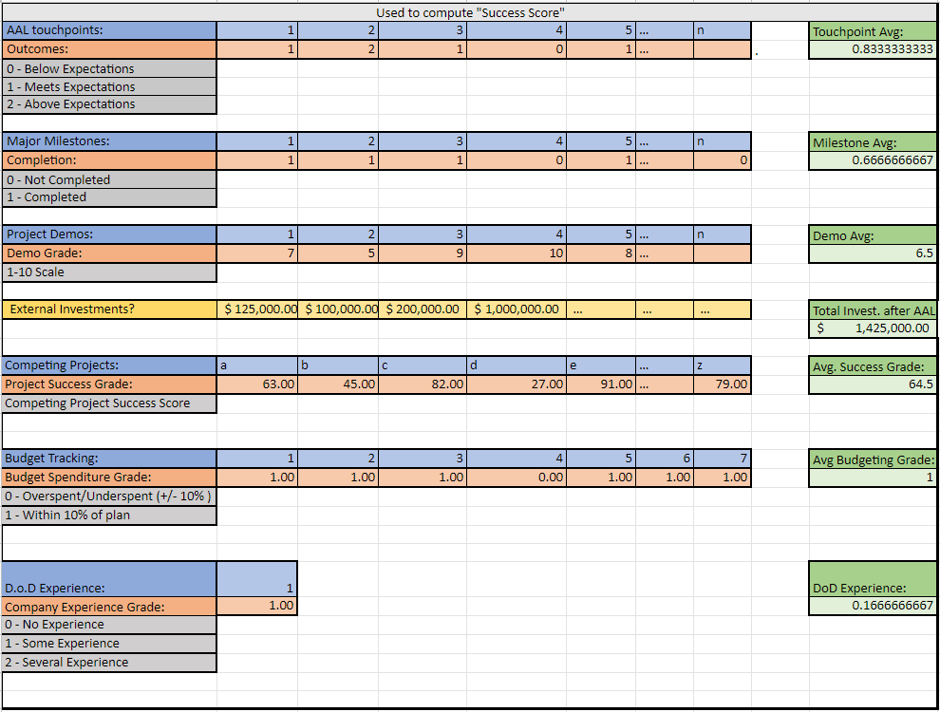
Notes:
Santana

Slide 10

3. Data Evaluation
Direct measurement of the quantitative success tool.
Simple dashboard:
Running total of the projects process
Shows past project success scores
Project success scores can be linked to companies to see company performance over time.
Notes:
Sanatana:
Come up with dashboard in excel and add picture

Slide 11

Competitive Advantage
Advantages:
Cohesion amongst project managers
Clear data tracking
Future predictions of project success or failures
Results:
Better communication
Scoring that can predict weak points amongst a project
A cohesive database that can be used for future prediction models
Notes:
Santana

Slide 12
Dual Use
Commercial Use:
Incubators
Academic Institutions
Venture Capital Firms
Non-Profits
D.o.D. Use:
DevCom - Army Research Laboratory
Army Applications Laboratory
Projects onboarded in the future
Notes:
Mualla

Slide 13
Next Steps:
Complete remaining interviews
25 Interviews Completed, 10 Interviews Planned
Discuss MVP with Dr.Perley
Get feedback
Next Steps:
‹#›
Notes:
Mualla

Slide 14
Questions?

Slide 15
References:
https://aal.army/
https://aal.army/what-we-do/
https://aal.army/our-team/
https://www.mckinsey.com/business-functions/strategy-and-corporate-finance/our-insights/how-to-take-the-measure-of-innovation

